Slide 1
ME469: A Verification and Validation (V&V) Methodology: Laboratory
Stefan P. Domino^{1,2}
¹ Computational Thermal and Fluid Mechanics, Sandia National Laboratories
² Institute for Computational and Mathematical Engineering, Stanford
SAND2018-4536 PE

Slide 2
Focus on Three Nalu/reg_tests/test_files/laboratory
2d_quad9_couette
2d_quad4_channel
3d_tet4_pipe

Slide 3
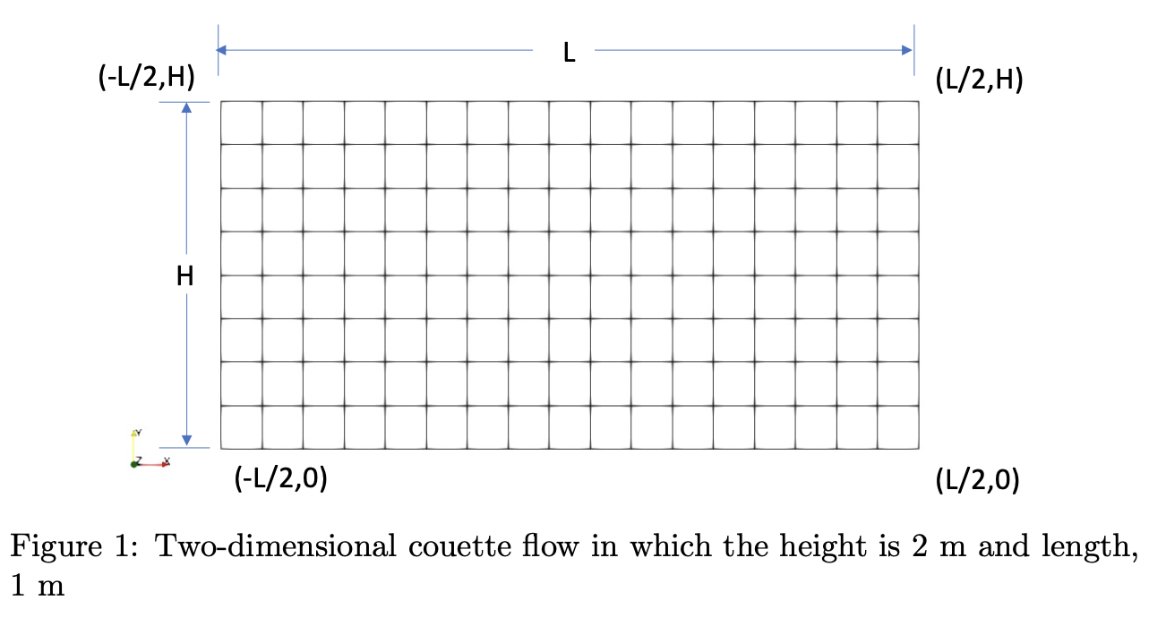
Nalu/reg_tests/test_files/laboratory/2d_quad9_couette: Setup
Top, imposed velocity
Bottom, no-slip wall
Left and right sides, periodic

Slide 4
Nalu/reg_tests/test_files/laboratory/2d_quad9_couette: Equations
Subject to the imposed conditions, the momentum equation reduces to:
With analytical solutions (at a given Reynolds number):
Simple, and a linear profile

Slide 5
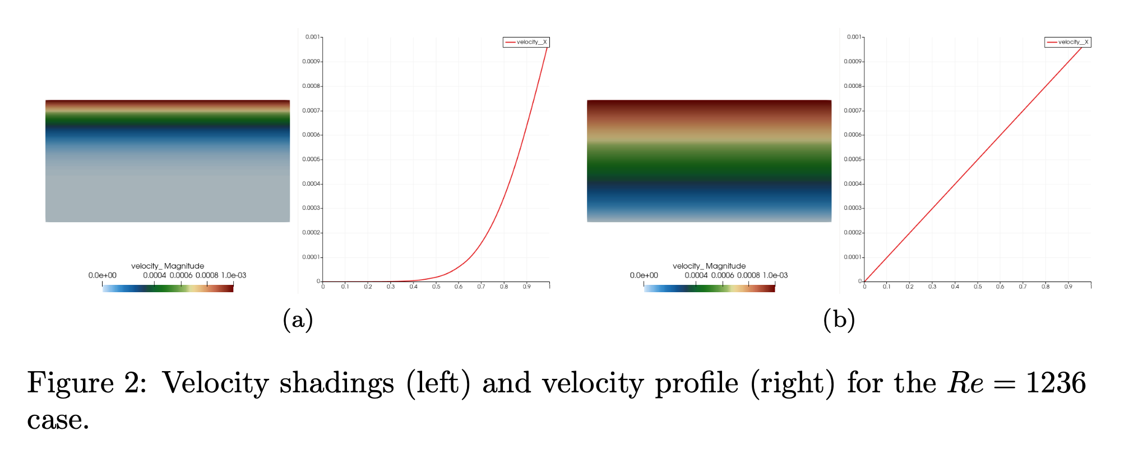
Nalu/reg_tests/test_files/laboratory/2d_quad9_couette: Findings
Start-up adds additional complexity to the solution, however, at steady state, our profile is predicted to be linear

Slide 6
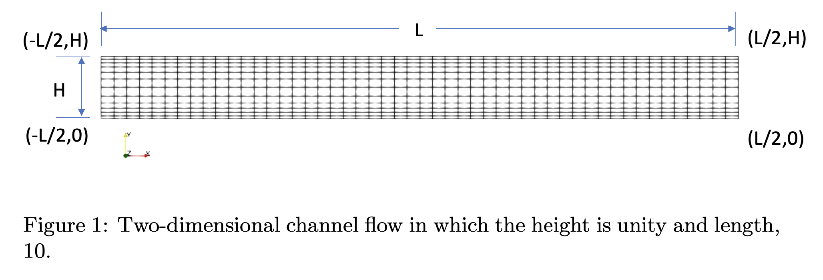
Nalu/reg_tests/test_files/laboratory/2d_quad4_channel: Setup
Top and bottom, no-slip wall
Left and right sides, either open (specified pressure drop) or with a body force, periodic

Slide 7
Nalu/reg_tests/test_files/laboratory/2d_quad4_channel: Equations
Subject to the imposed conditions, the momentum equation reduces to:
With analytical solutions (at a given Reynolds number):
Quadratic profile
Please review write-up for specification of Reynolds number, wall shear stress, and pressure gradient balance

Slide 8
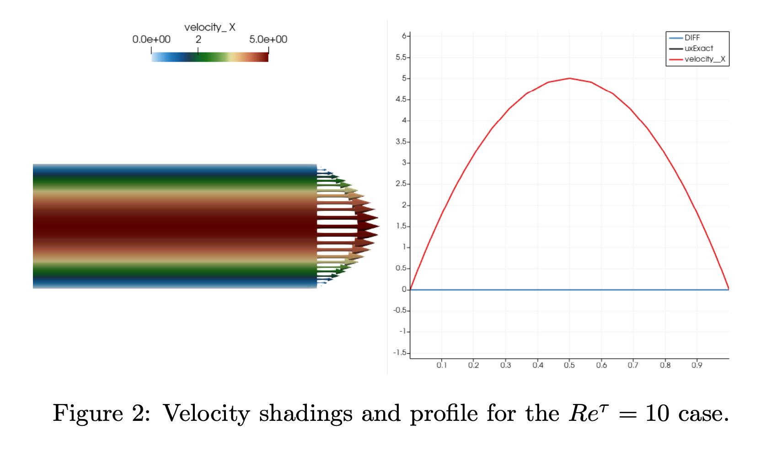
Nalu/reg_tests/test_files/laboratory/2d_quad9_channel: Findings
Quadratic solution, using a second-order scheme, is captured at the degree-of-freedom locations, without differences wrt the analytical solution
However, the wall shear stress is not – why?

Slide 9
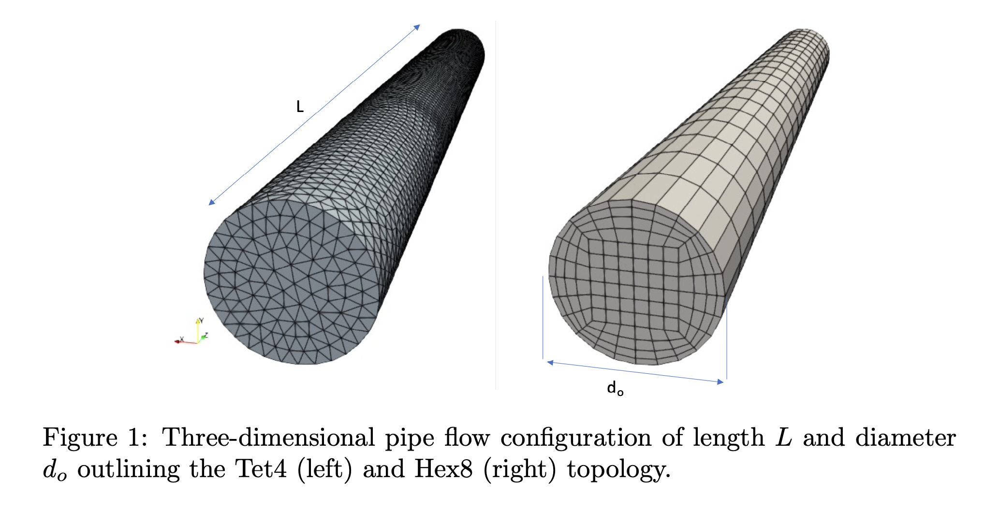
Nalu/reg_tests/test_files/laboratory/3d_tet4_pipe: Setup
Outer cylinder, no-slip wall
Front and back sides, either open (specified pressure drop) or with a body force, periodic
Tet4 and Hex8 mesh shown below

Slide 10
Nalu/reg_tests/test_files/laboratory/ 3d_tet4_pipe : Equations
Subject to the imposed conditions, the axial momentum equation (cylindrical coordinates) reduces to:
With analytical solutions (at a given Reynolds number):
Quadratic profile
Please review write-up for specification of Reynolds number, wall shear stress, and pressure gradient balance

Slide 11
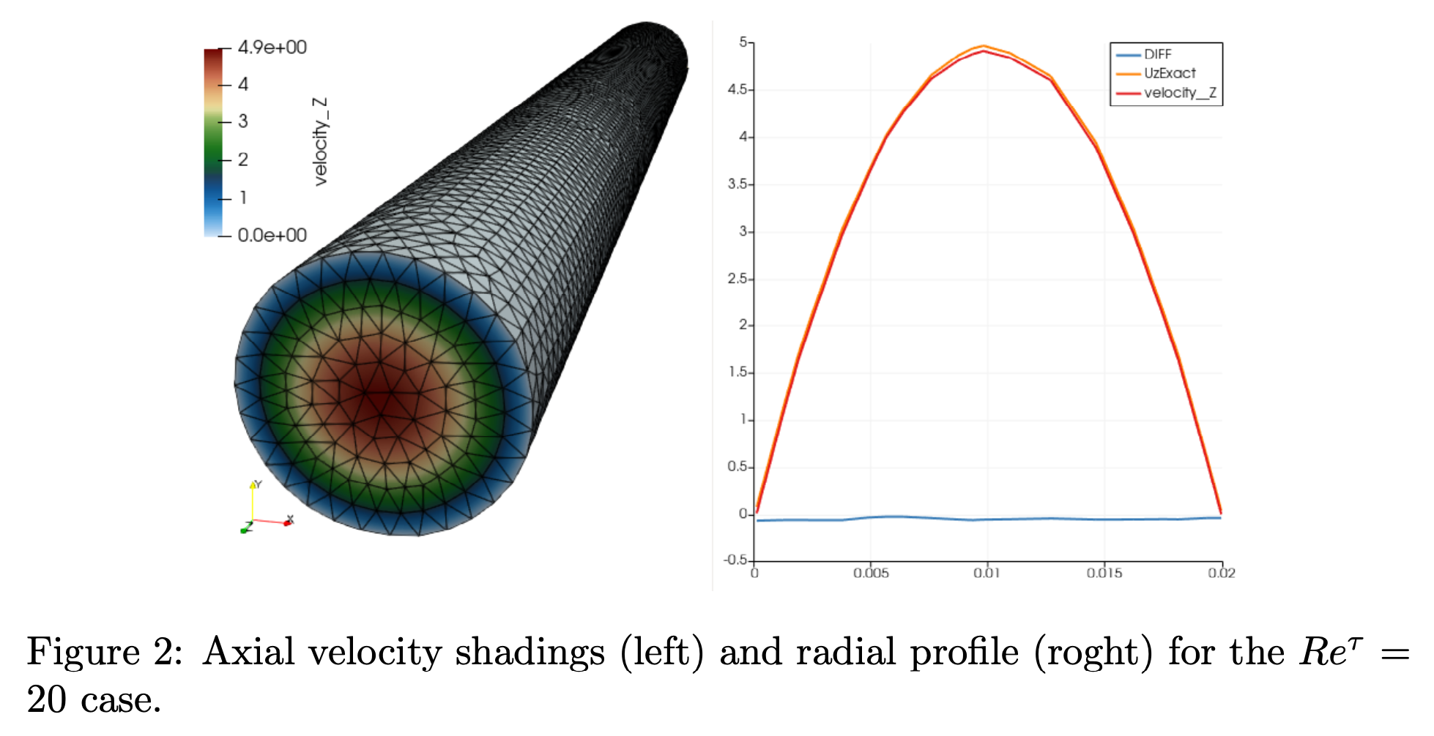
Nalu/reg_tests/test_files/laboratory/2d_quad9_channel: Findings
Quadratic solution, using a second-order scheme now demonstrates error as compared to the analytical solution, why?
The lab exercise overviews the difference in error when using Tet4 and Hex8 mesh.

Slide 12
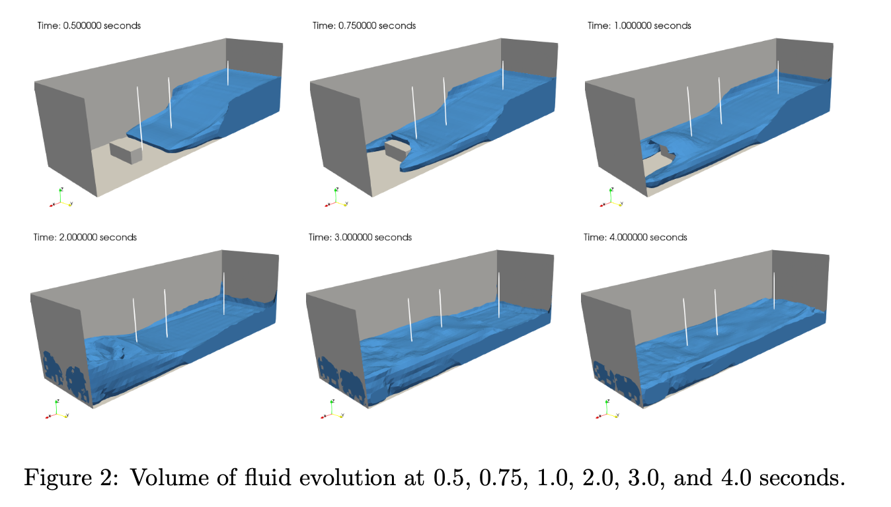
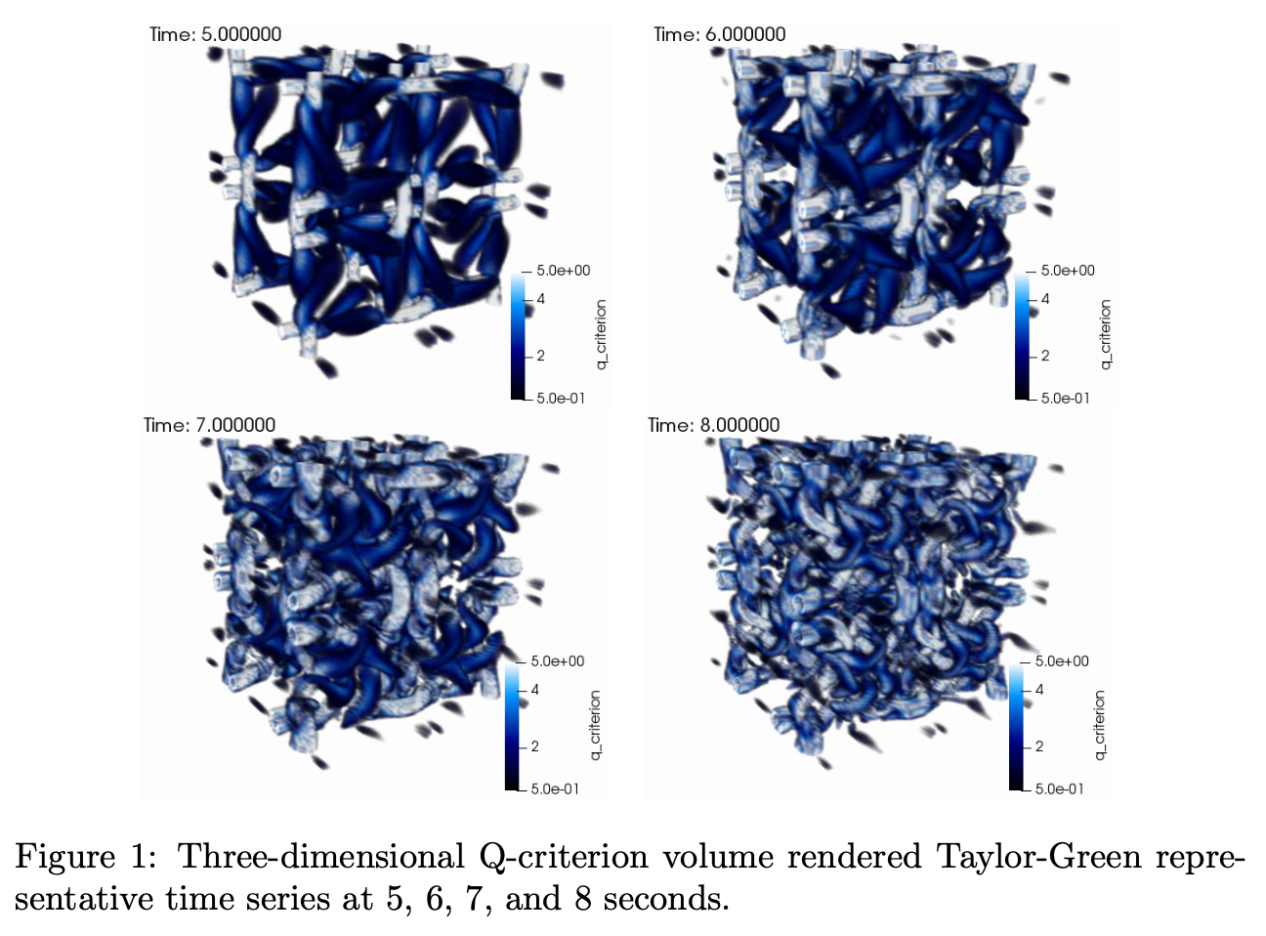
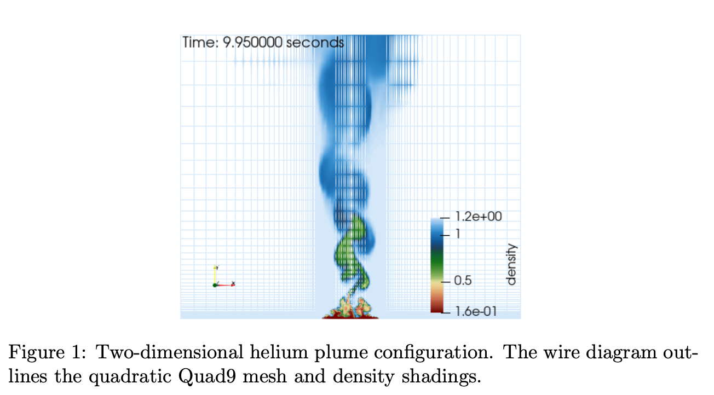
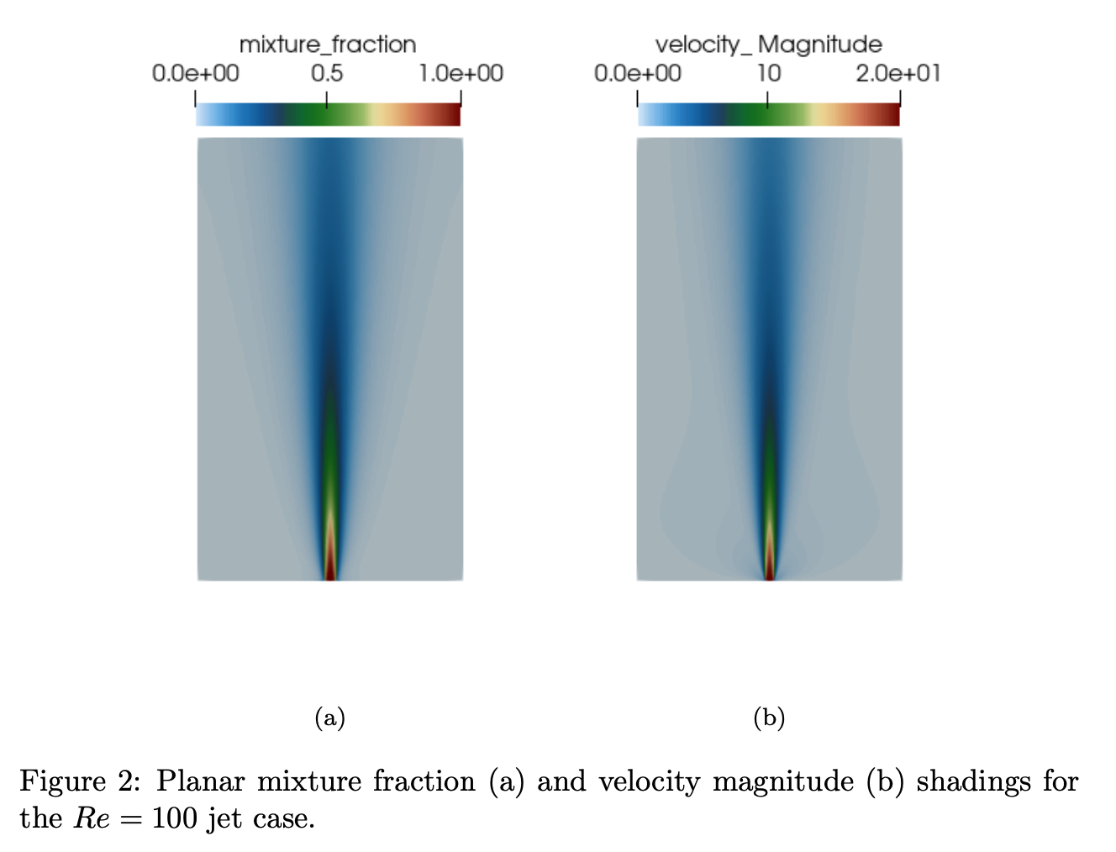
Conclusions
In low-Mach fluid mechanics, we have a limited set of analytical solutions that can be used to ensure that neither coding nor conceptual discretization-like mistakes have been made
In this module, we have reviewed three of the simplest cases
As complexity increases, the method of manufactured solution (MMS) becomes. Powerful tool to ensure that the numerical scheme is converging as expected
Other labs: dam break, Taylor Green decay, helium plume, open jet (see /laboratory for more)

